Slide 1
INTRODUCTION TO MARKETING
0
Chapter 3
The Cultural
Environment
NGUYEN THI PHUONG*
THANG LONG UNIVERSITY
*MA in Global Marketing, PHD in Economics

Slide 2
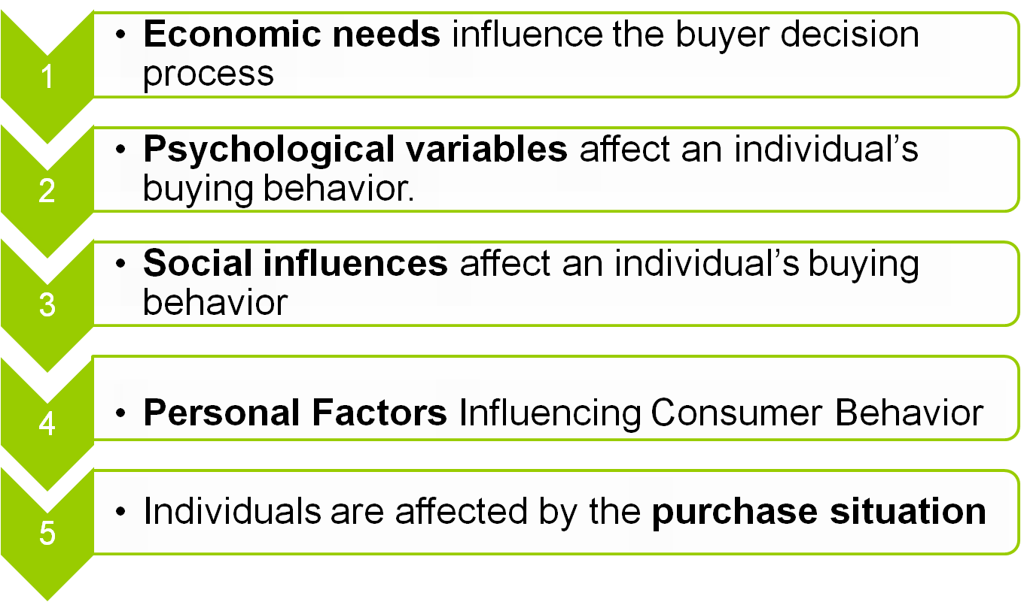
SESSION 5: Consumer buying behavior
Copyright © 2011 Pearson Education
15-<number>

Slide 3

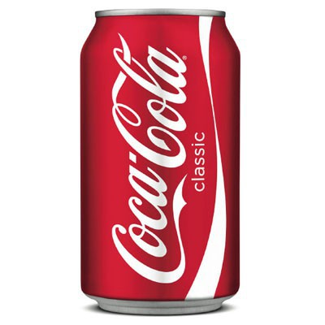
Why a given consumer buys a specific brand of soft drink?
Copyright © 2011 Pearson Education
15-<number>
Notes:
maximize their utility

Slide 4
Why some consumers look for the lowest price. Others will pay extra for convenience?
There are general behavioral that marketing managers can apply to better understand their specific target markets.
Copyright © 2011 Pearson Education
15-<number>

Slide 5
5.1 Influences of economic needs
Economic needs guide most consumer behavior. Economic needs are concerned with making the best use of a consumer’s time and money.
Some economic needs are.
Economy of purchase or use
Convenience
Efficiency in operation or use
Dependability in use
Improvement of earnings
Copyright © 2011 Pearson Education
15-<number>

Slide 6
Most consumers appreciate firms that offer them improved economic value for the money they spend
Question: improved value means offering lower and lower prices??
Improved value can be:
Product design, Product quality (last longer)
Promotion (product benefits: the length of the guarantee, time a product will save)
Service
Copyright © 2011 Pearson Education
15-<number>

Slide 7
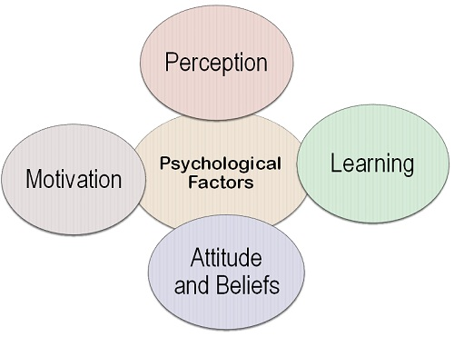
5.2 Psychological influences
The Psychological Factors are the factors that talk about the psychology of an individual that drive his actions to seek satisfaction.
Some of the important Psychological Factors are:
Copyright © 2011 Pearson Education
15-<number>

Slide 8
Motivation: The level of motivation influences the buying behavior of the consumers. It is very well explained by Maslow through his need hierarchy theory comprising of basic needs, security needs, social needs, esteem needs and self-actualization needs.
Copyright © 2011 Pearson Education
15-<number>

Slide 9
Needs motivate a person to do something. Needs involve a person’s physical well – being, individual’s self – view and relationship with others.
Needs are more basic than wants. Wants are “needs” that are learned during a person’s life
For example: everyone needs water or some kind of liquid, but some people also want Canadian’s raspberry-flavored water on the rocks
Copyright © 2011 Pearson Education
15-<number>

Slide 10
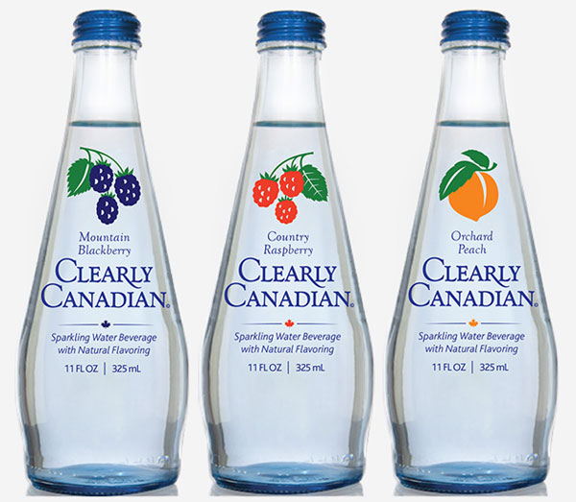

Copyright © 2011 Pearson Education
15-<number>

Slide 11
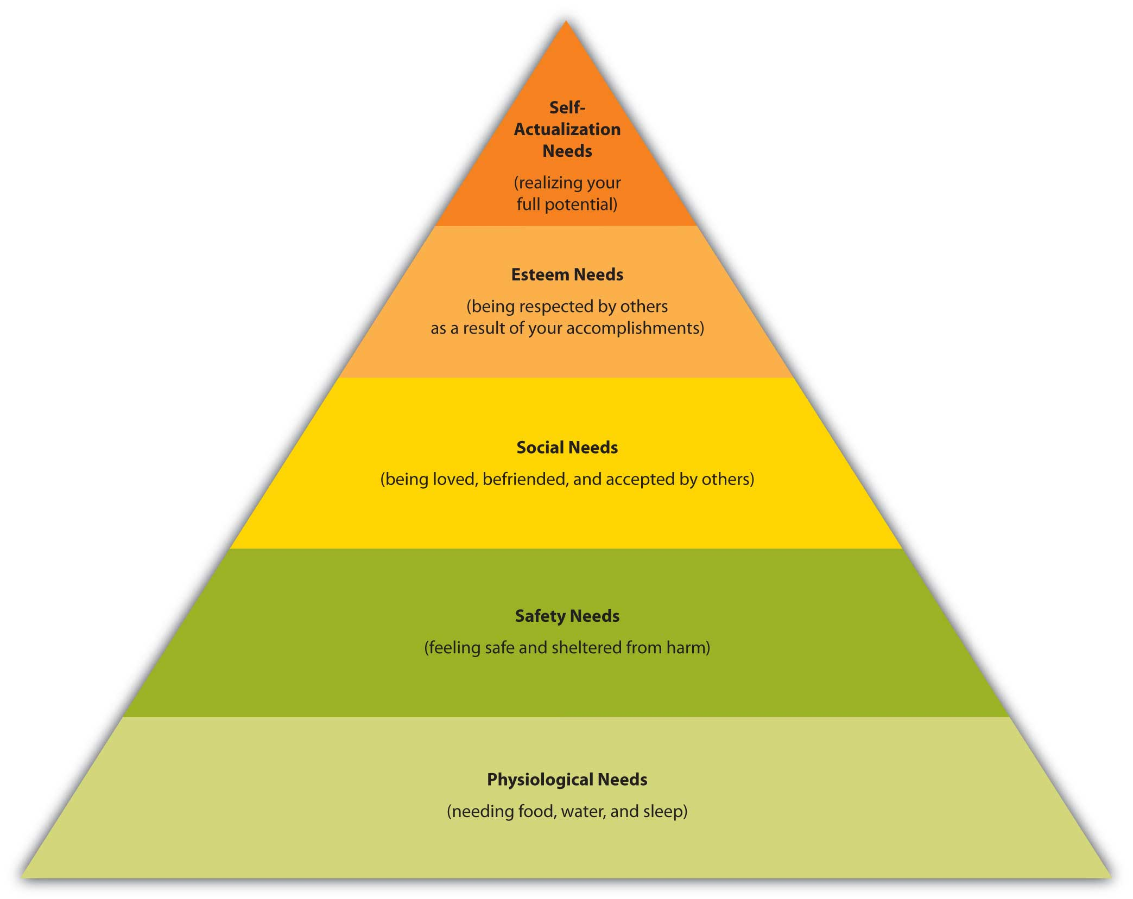
Maslow’s Hierarchy of Needs
Copyright © 2011 Pearson Education
15-<number>

Slide 12
Perception: is the process through which the individual selects, organize and interpret the information to draw a meaningful conclusion.
For example, Apple iPhone is perceived as a premium brand and consumers are motivated to buy it to get associated with the elite class of the society.
Copyright © 2011 Pearson Education
15-<number>

Slide 13
Learning: The individual’s learning depends on the skills, knowledge and intention. The skills are developed through practice while the knowledge and intention are acquired with the experience.
Attitudes and Beliefs are the tendency to respond to a given product in a particular way, and these make up the brand image that influences the consumer buying behavior.
Copyright © 2011 Pearson Education
15-<number>

Slide 14
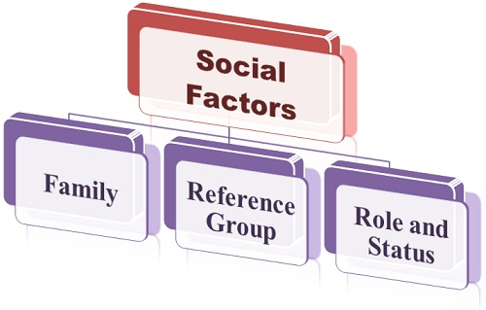
5.3 Social influences
The Social Factors are factors that are popular in the society where a consumer live in. The society is composed of several individuals that have different preferences and behaviors
Copyright © 2011 Pearson Education
15-<number>

Slide 15
Family: The family members play a crucial role in designing one’s preferences and behavior.
For example, a child develops his buying behavior and preferences by watching his parents and tend to buy the same products or services even when he grows old
The family can influence the buying behavior of an individual in either of the two ways:
personality, attitude, beliefs, characteristics
decision making of an individual.
Copyright © 2011 Pearson Education
15-<number>

Slide 16
Reference Group: is a group with which an individual likes to get associated, i.e. want to be called as a member of that group. The reference group share common buying behavior and have a strong influence over each other
Initiator (who initiates the buying decision)
Influencer (whose opinion influences the buying decision)
Decision-Maker (who has the authority to take the purchase decision)
Buyer (who ultimately buys the product).
Copyright © 2011 Pearson Education
15-<number>
Notes:
người khởi xướng, người tạo ra ảnh hưởng, người ra quyết định người mua

Slide 17
Roles and Status: An individual’s position and role in the society also influences his buying behavior. Such as, a person holding a supreme position in the organization is expected to purchase those items that advocate his status.
Copyright © 2011 Pearson Education
15-<number>

Slide 18
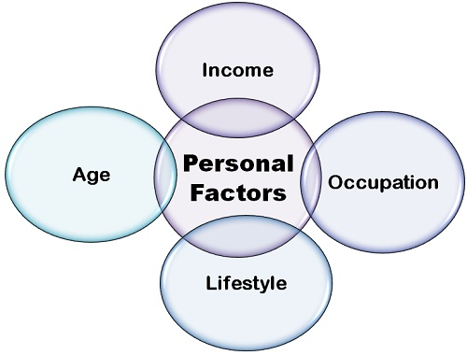
5.4 Personal Factors
Copyright © 2011 Pearson Education
15-<number>

Slide 19
Age: The consumer buying behavior is greatly influenced by his age, i.e. the life cycle stage
Income: The income decides the purchasing power of an individual
Occupation: The people tend to buy those products and services that advocate their profession and role in the society
Lifestyle: means individual’s interest, values, opinions and activities that reflect the manner in which he lives in the society
Copyright © 2011 Pearson Education
15-<number>

Slide 20
5.5 Purchase situation
Time
Surroundings
Store locations
Physical: layout of a store, music played at stores, the lighting, temperature, and even the smells
Crowding
Copyright © 2011 Pearson Education
15-<number>

Slide 21
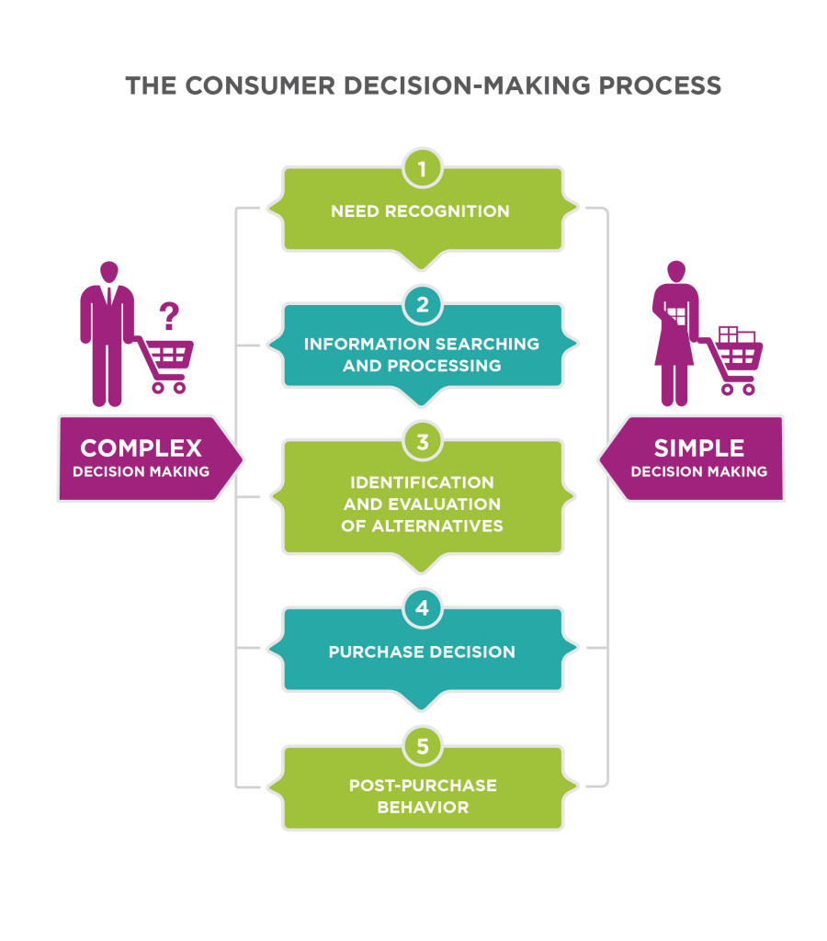
5.6 The consumer decision process
Copyright © 2011 Pearson Education
15-<number>

Slide 22
Other approach of decision process
Awareness – the potential customer comes to know about the product but lacks details. The customer may not even know how it works or what it will do.
Interest – if the consumer becomes interested, he or she will gather general information and facts about the product.
Evaluation – a consumer begins to give the product a mental trial, applying it to his or her personal situation
Copyright © 2011 Pearson Education
15-<number>

Slide 23
Trial – the consumer may buy the product to experiment with it in use.
Decision – the consumer decides on either adoption or rejection. A satisfactory evaluation and trial may lead to adoption of the product and regular use.
Confirmation –rethink the decision and searches for support for the decision – that is, further reinforcement.
Copyright © 2011 Pearson Education
15-<number>

Slide 24
Homework
1. Give an example of a recent purchase experience in which you were dissatisfied because a firm’s marketing mix did not meet your expectations. Indicate how the purchase fell short of your expectations.
2. Give two examples of recent purchase where the specific purchase situation influenced your purchase decision. Briefly explain how your decision was affected
Copyright © 2011 Pearson Education
15-<number>

